Slide 1
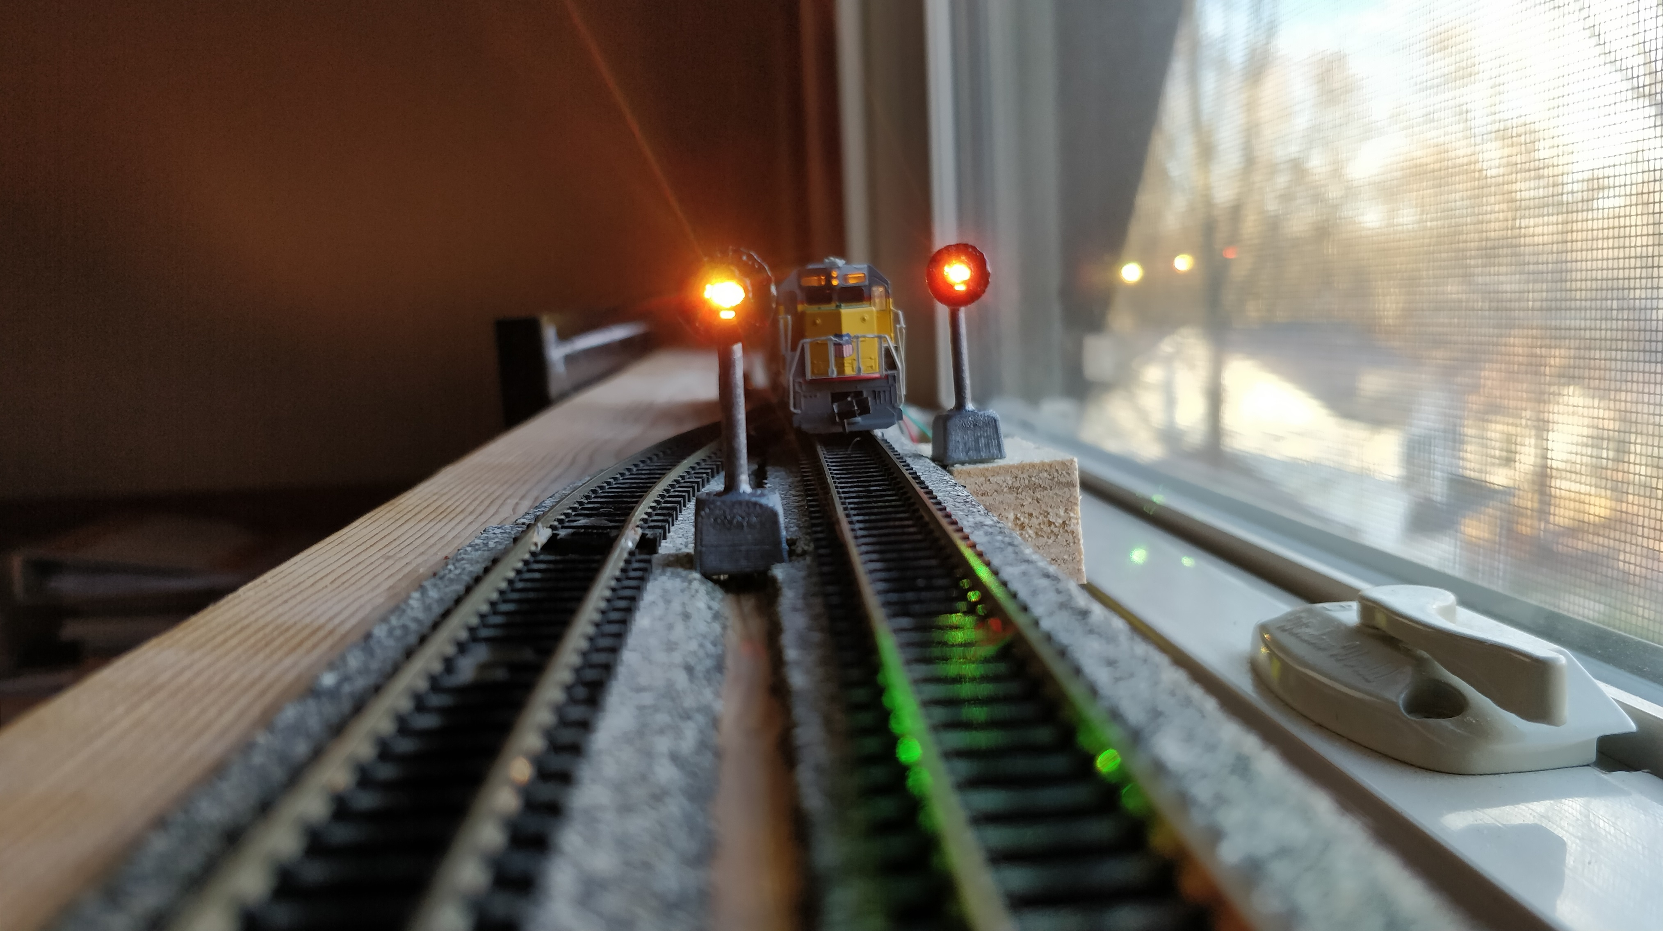
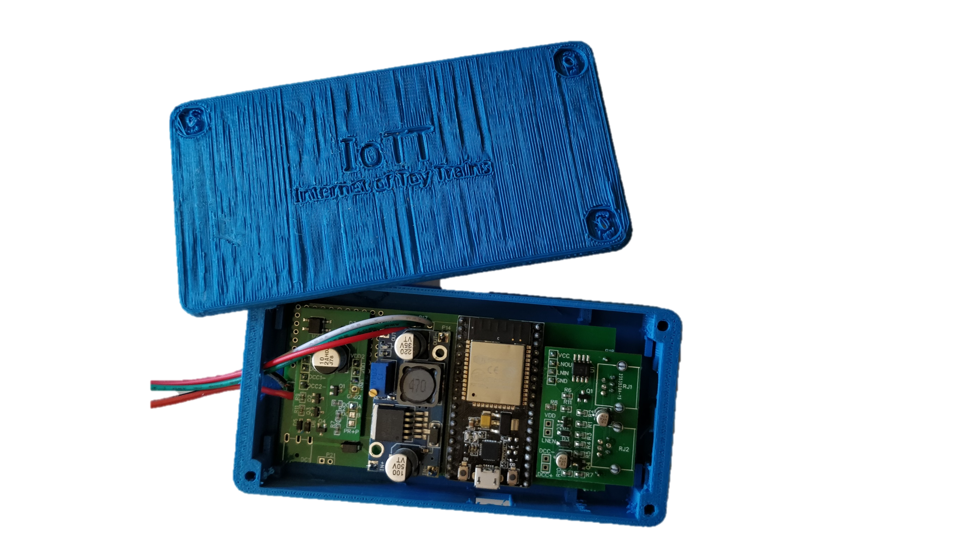
Signaling
System
Hardware

Slide 2
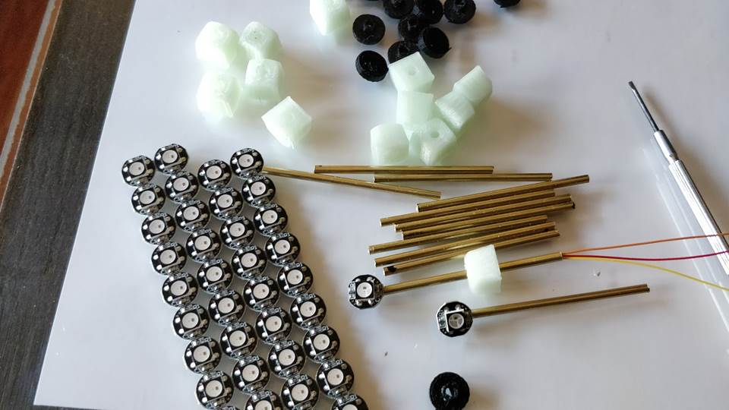

Slide 3
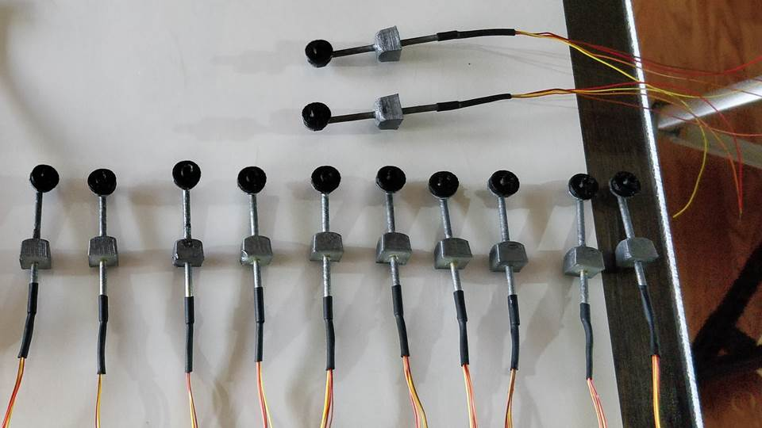

Slide 4
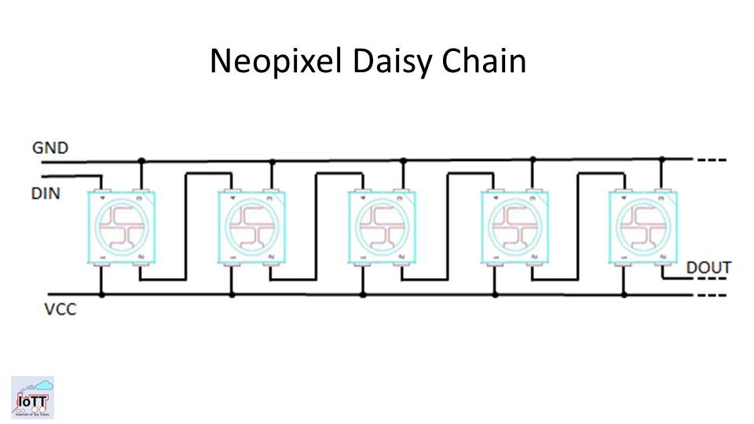

Slide 5


Slide 6
Signal System Capabilities
Number of Signals only limited by device memory. 200+ signals are realistic with just one signaling device
Can receive aspect commands via LocoNet, DCC Track Signal, or Wifi (MQTT Gateway)
Supports full range of Switch Addresses as well as Extended Accessory Decoder commands (NMRA Signal commands supporting 36 Aspects)
All signals can be different regarding number of LED’s, number of aspects, colors, etc.
Supports up to 4 switch addresses per signal for a maximum of 16 Aspects in static or 8 Aspects in dynamic mode
Simple 3-wire cable for serial connection chain to all signals
Graphical user interface with built-in simulator for the design of aspects of each signal, depending on number of lamps on the signal

Slide 7
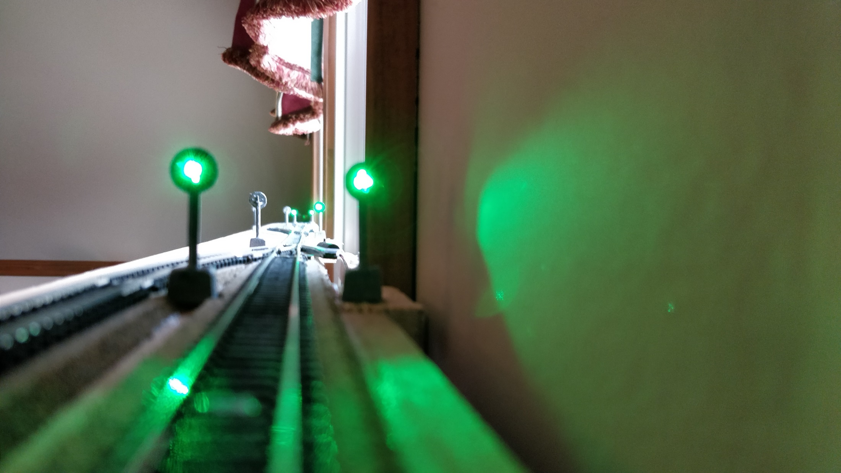

Slide 8
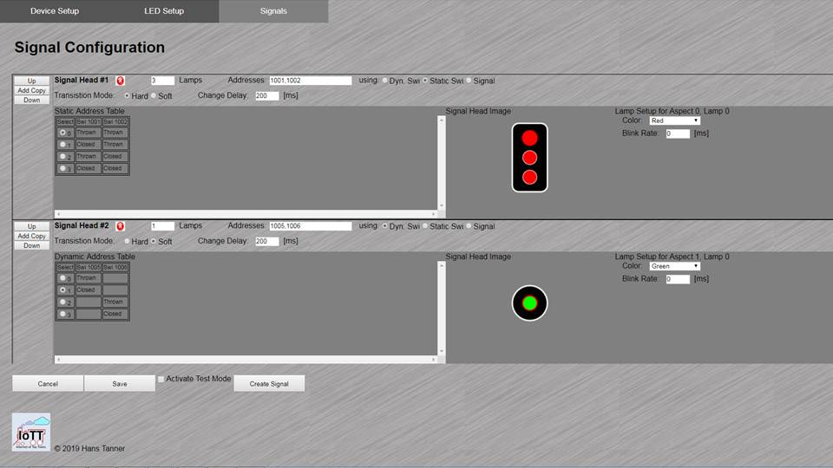

Slide 9
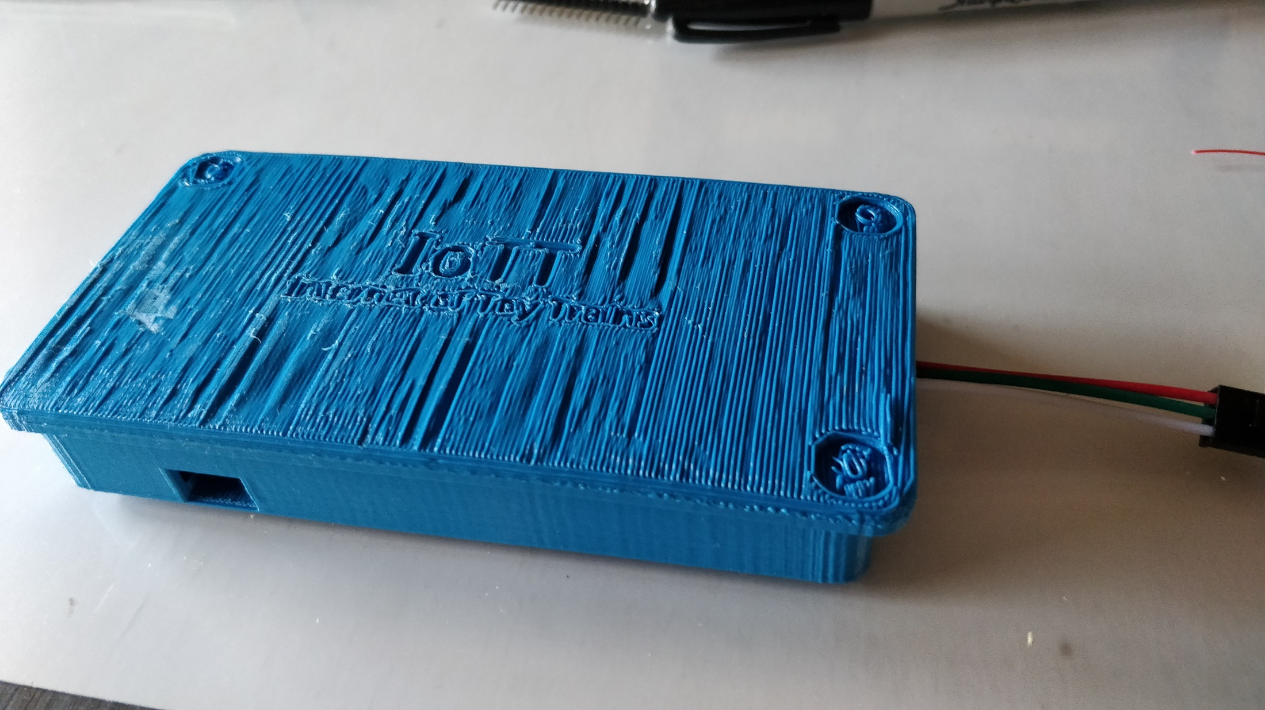

Slide 10
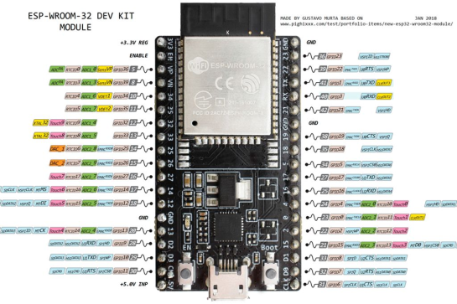
BlueBox Signal Controller
WS2812
Connector
DCC_A
DCC_B
GND
VCC
VDD
LN_En
RxD
TxD
DCC_1
DCC_2
GND
VDD
DCC_A
DCC_B
CP+
DC+
GND
VCC
GND
DCC_A
GND
LN+
LN+
GND
DCC_B
DCC Interface
DC/DC Converter
LocoNet Interface
Hardware Modules

Slide 11
Cost of module
administration
and technical
maintenance
Main cost driver: Configuration
Logic and Rules
Main cost driver:
Diversity of parts and modules
Minimal Cost
Degree of Modularization

Slide 12
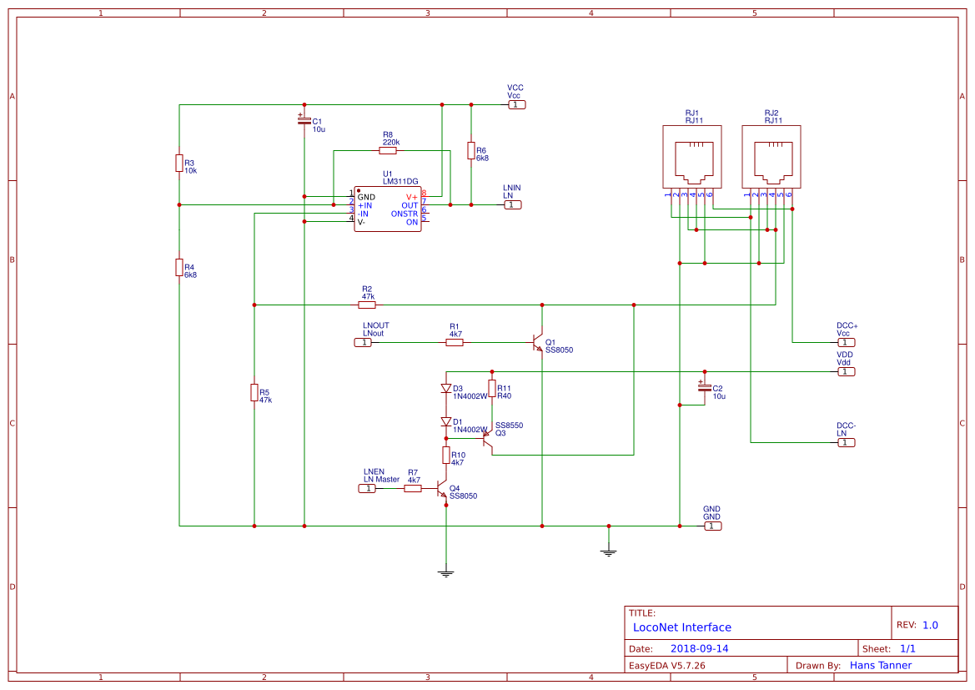
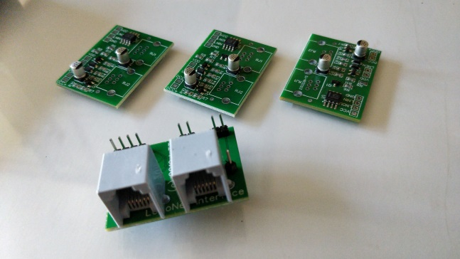
Comparator to generate RxD Signal
TxD LocoNet Transmitter Transistor
15mA Current Source
LocoNet Termination
For use as LocoNet Master

Slide 14
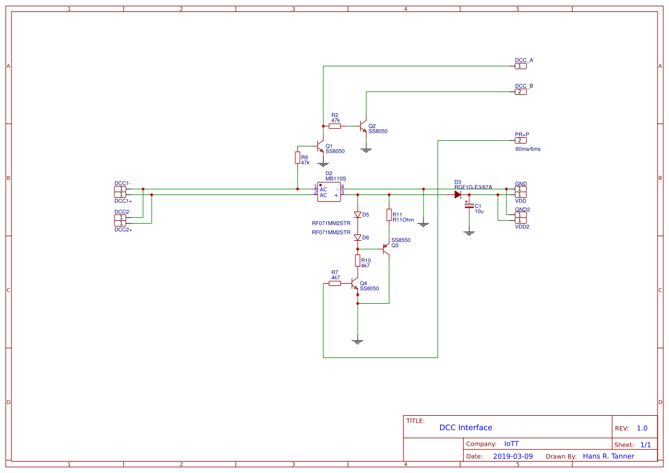
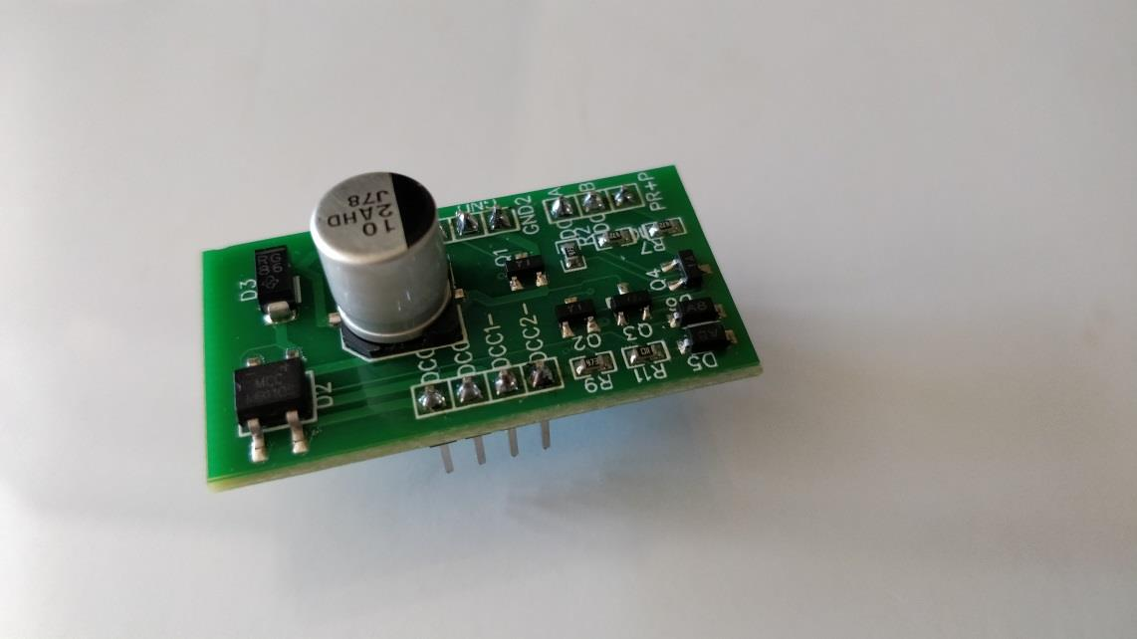
Dual Phase DCC Signal
Decoder input
Booster driver (H-Bridge)
2 Amp. DC Output
- typ. 12-24V
Track Input
60mA Current Sink
with Enable Input
to generate 6ms ACK Pulse on Service Mode Programming Track

Slide 16
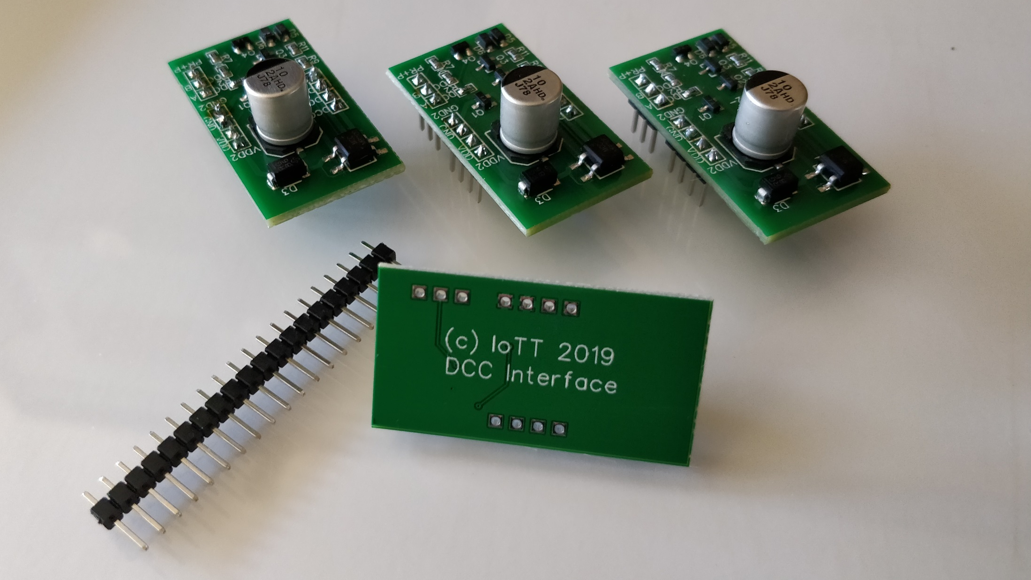

Slide 17
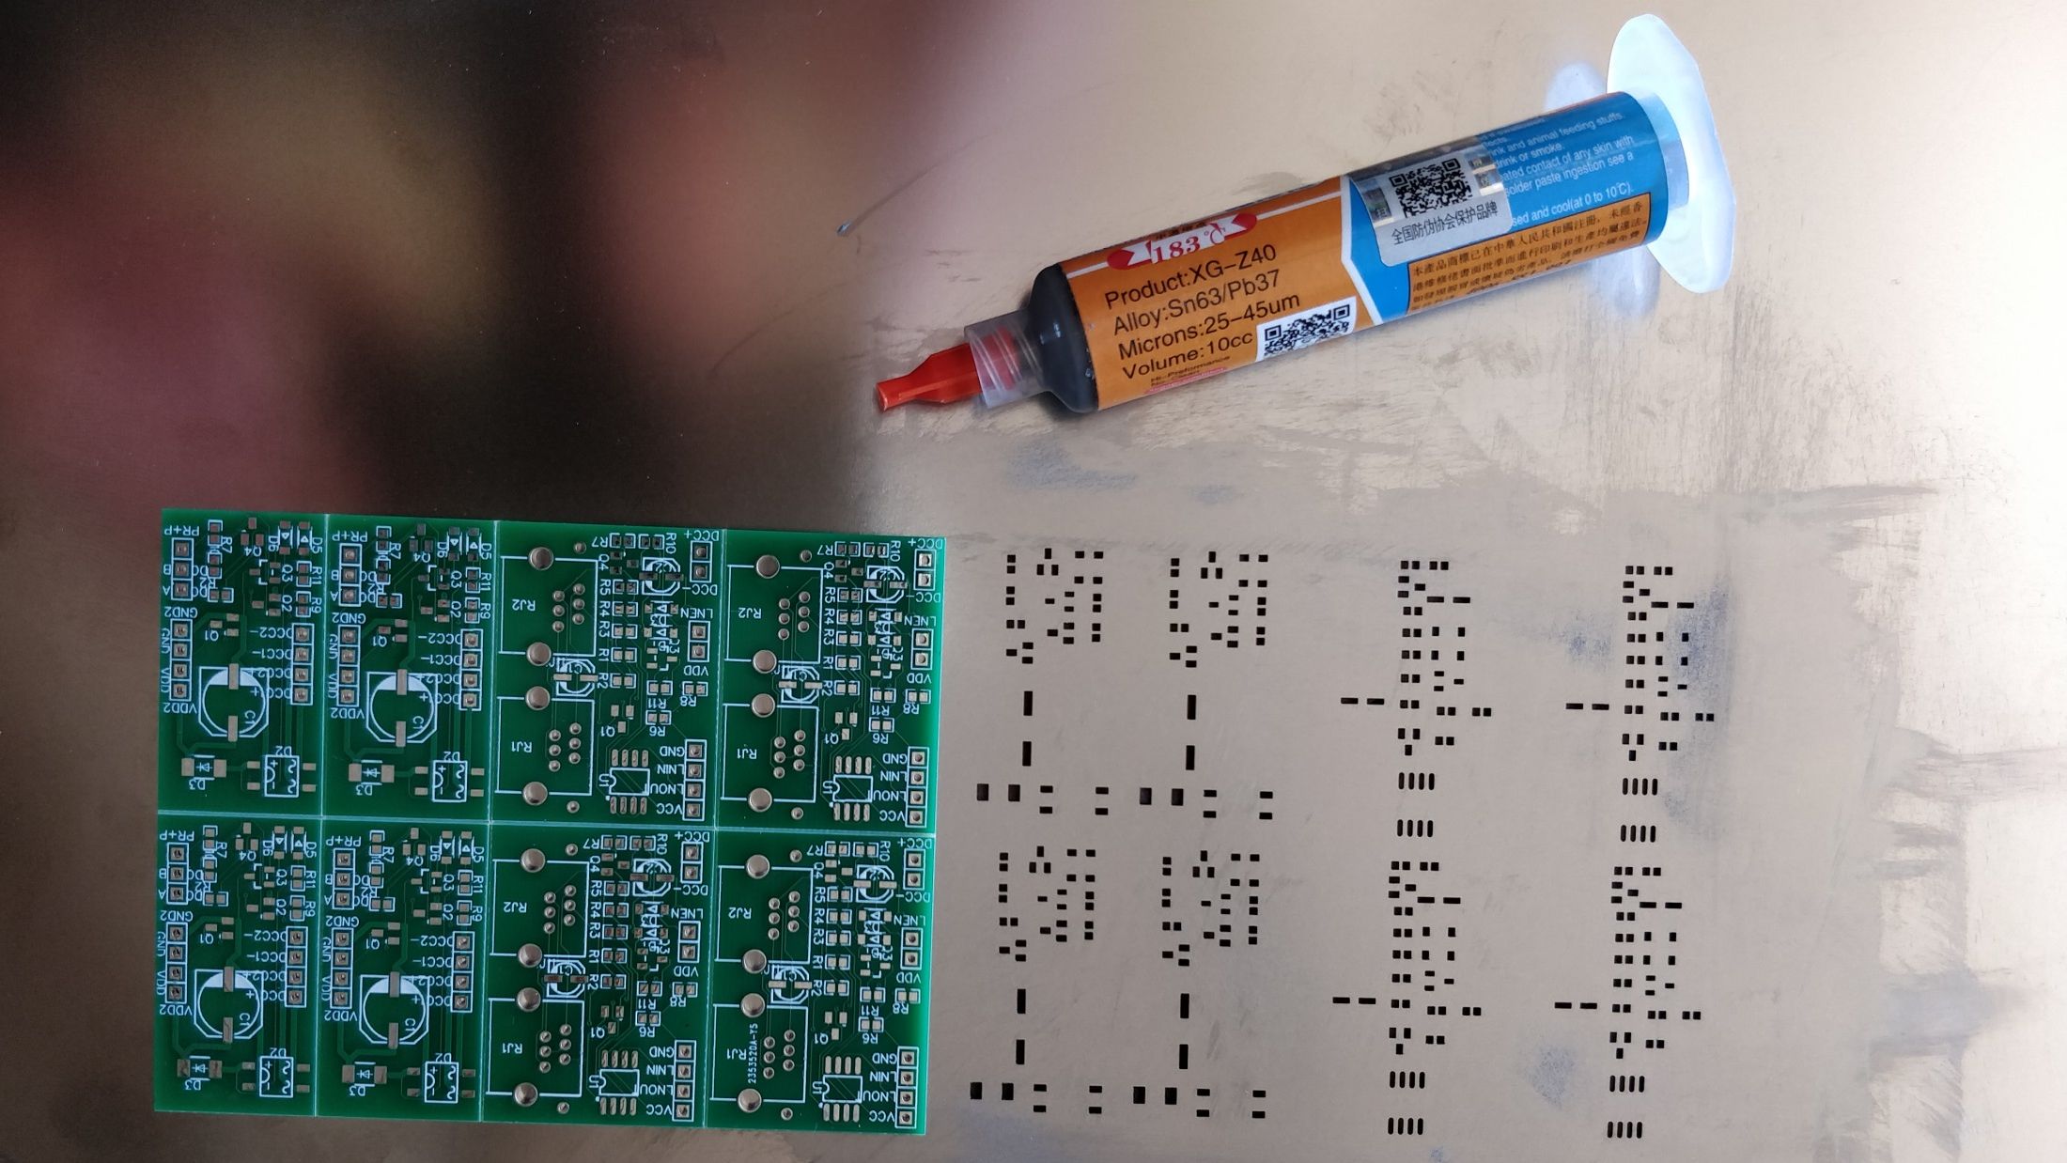

Slide 18
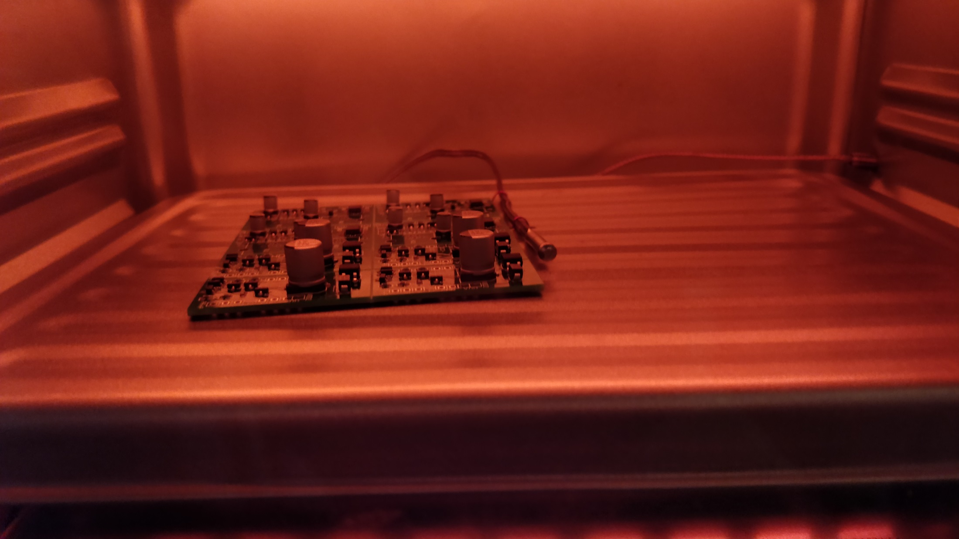

Slide 19
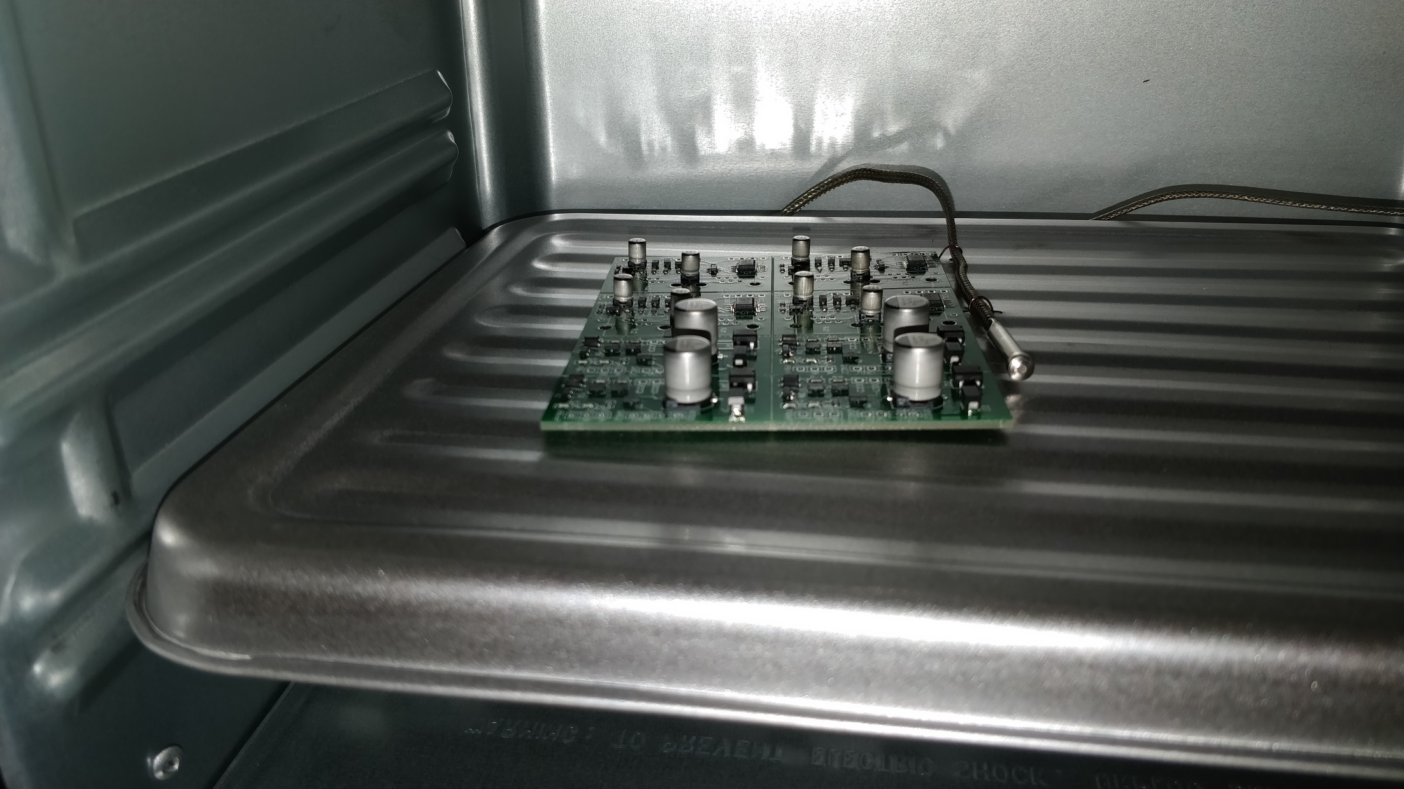

Slide 20
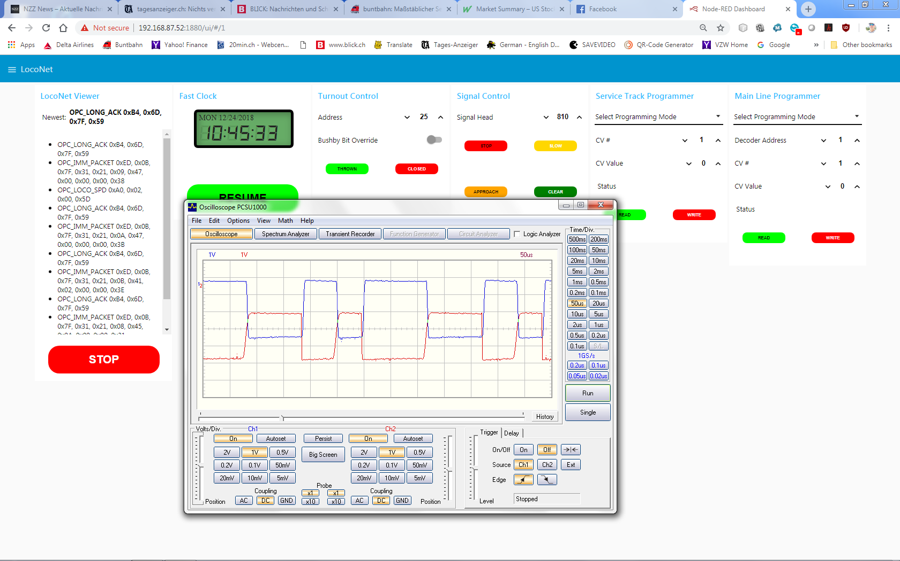
Blue: DCC-A on 1kOhm Pullup to 3.3V
Red: DCC-B on 15kOhm Pullup to 3.3V (will not properly decode)
Recommended Pullup: 1 - 4.7kOhm

Slide 21
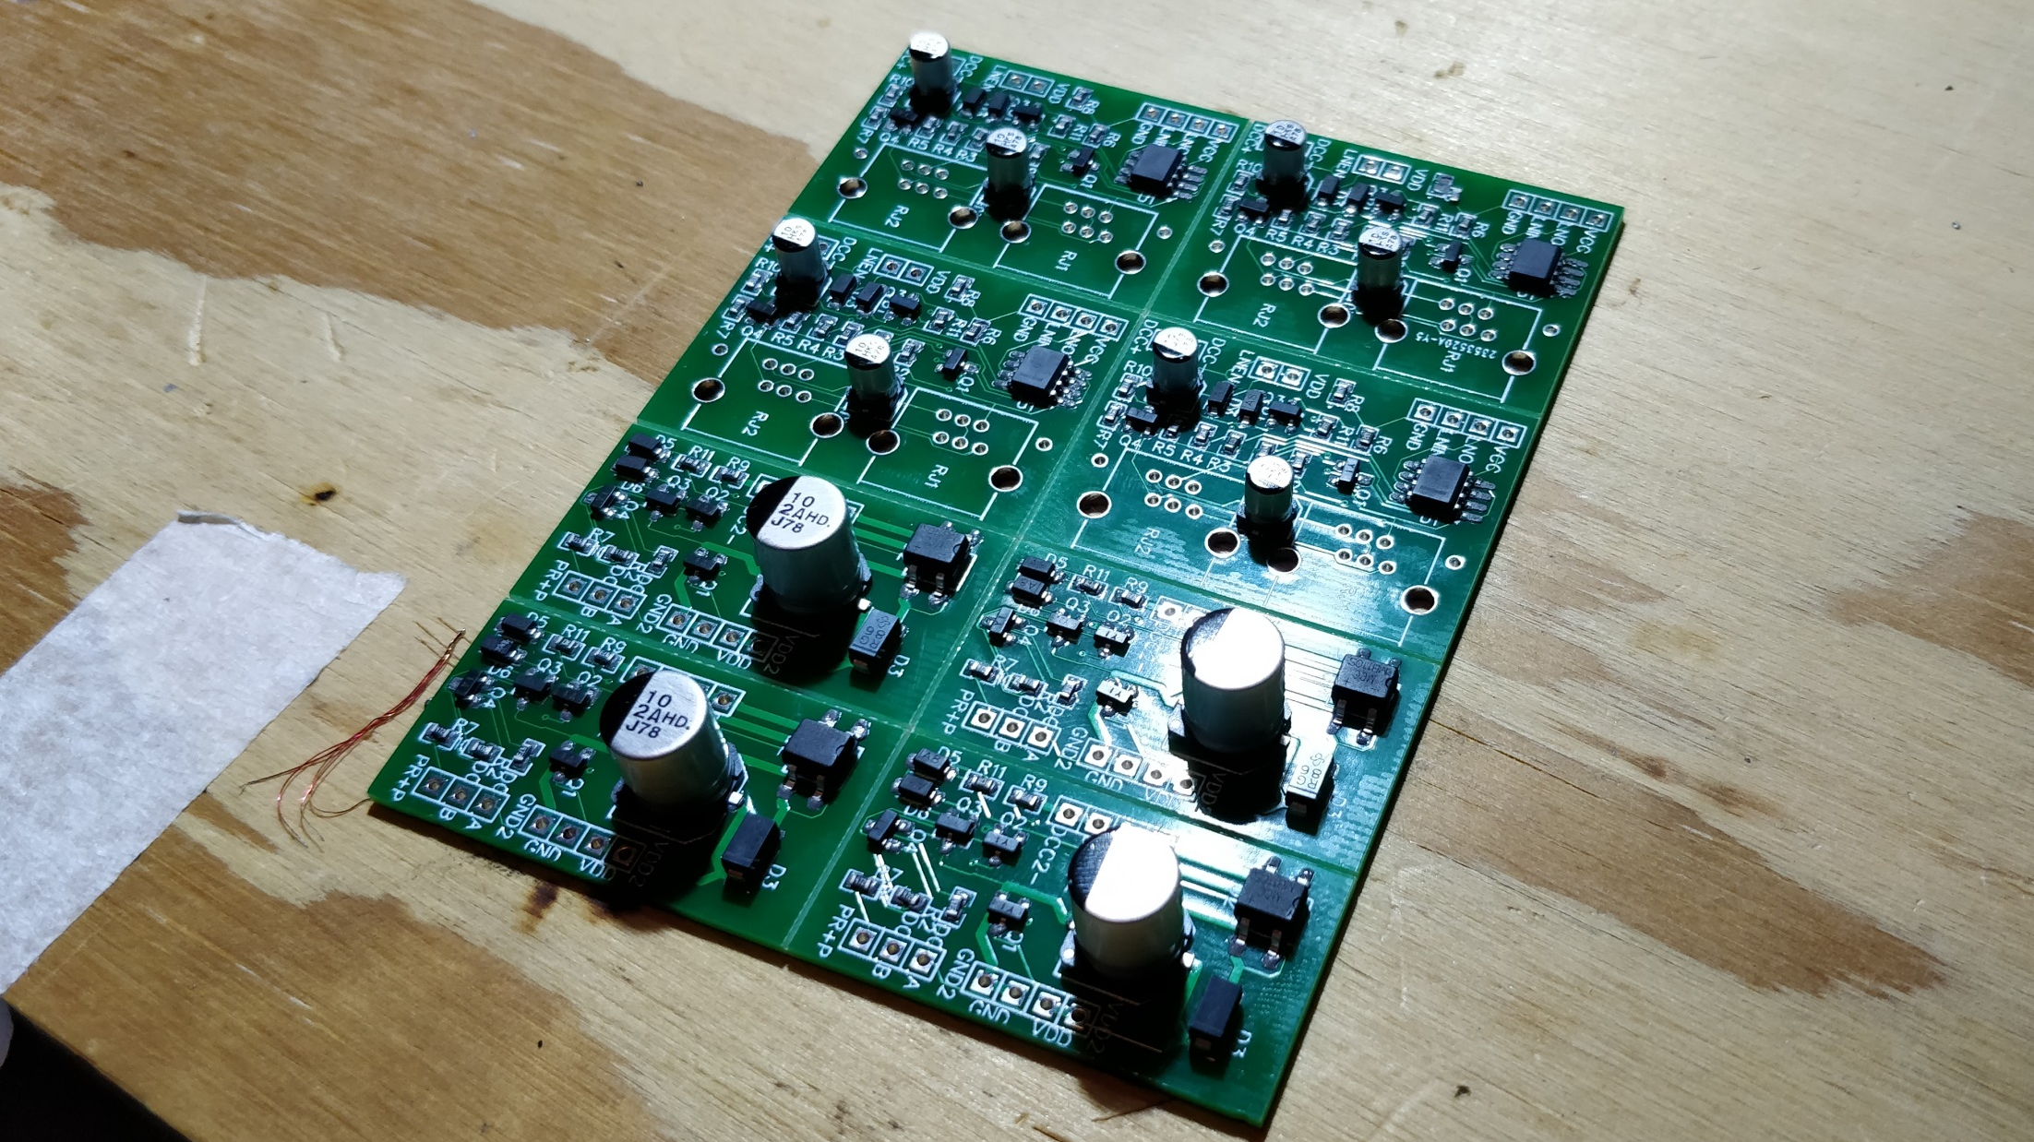

Slide 22
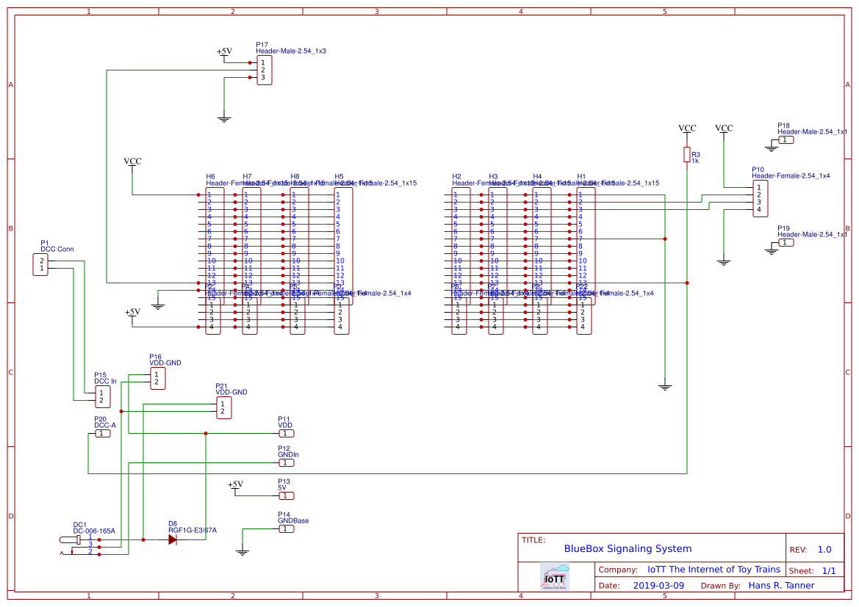
DCC Pullup Resistor
Protection Diode

Slide 23
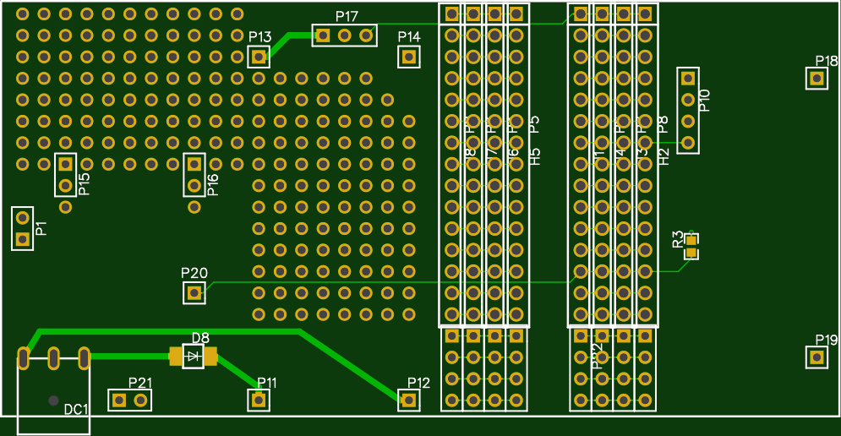
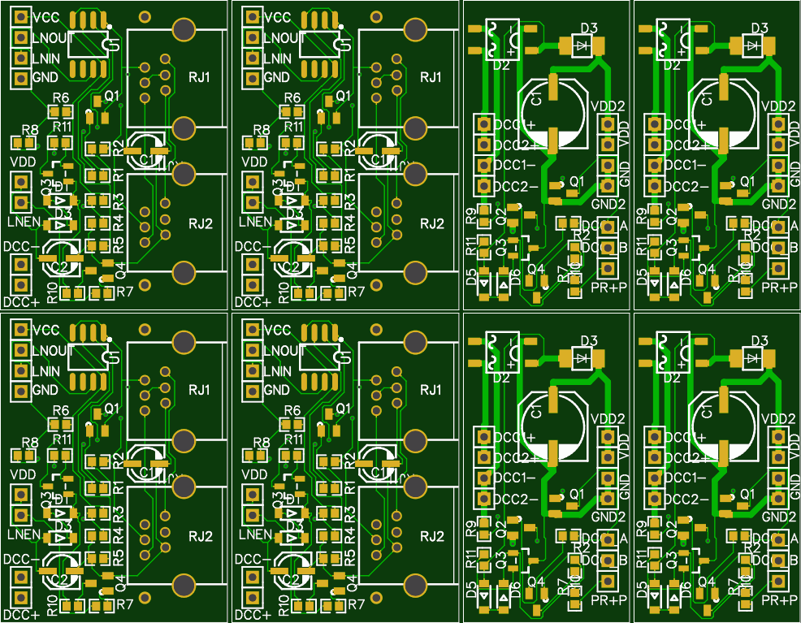

Slide 24
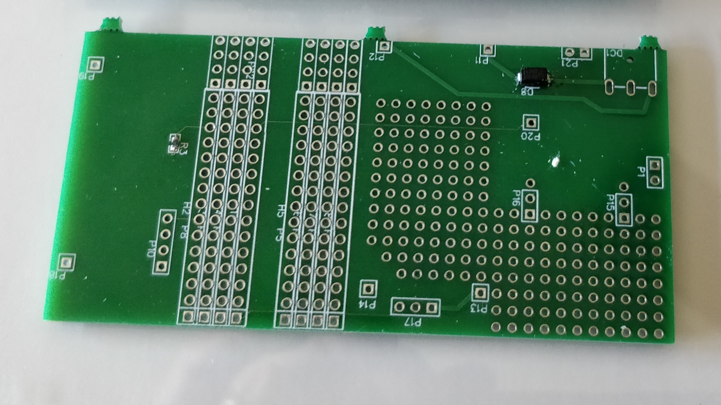
Pullup Resistor
Protection Diode

Slide 25
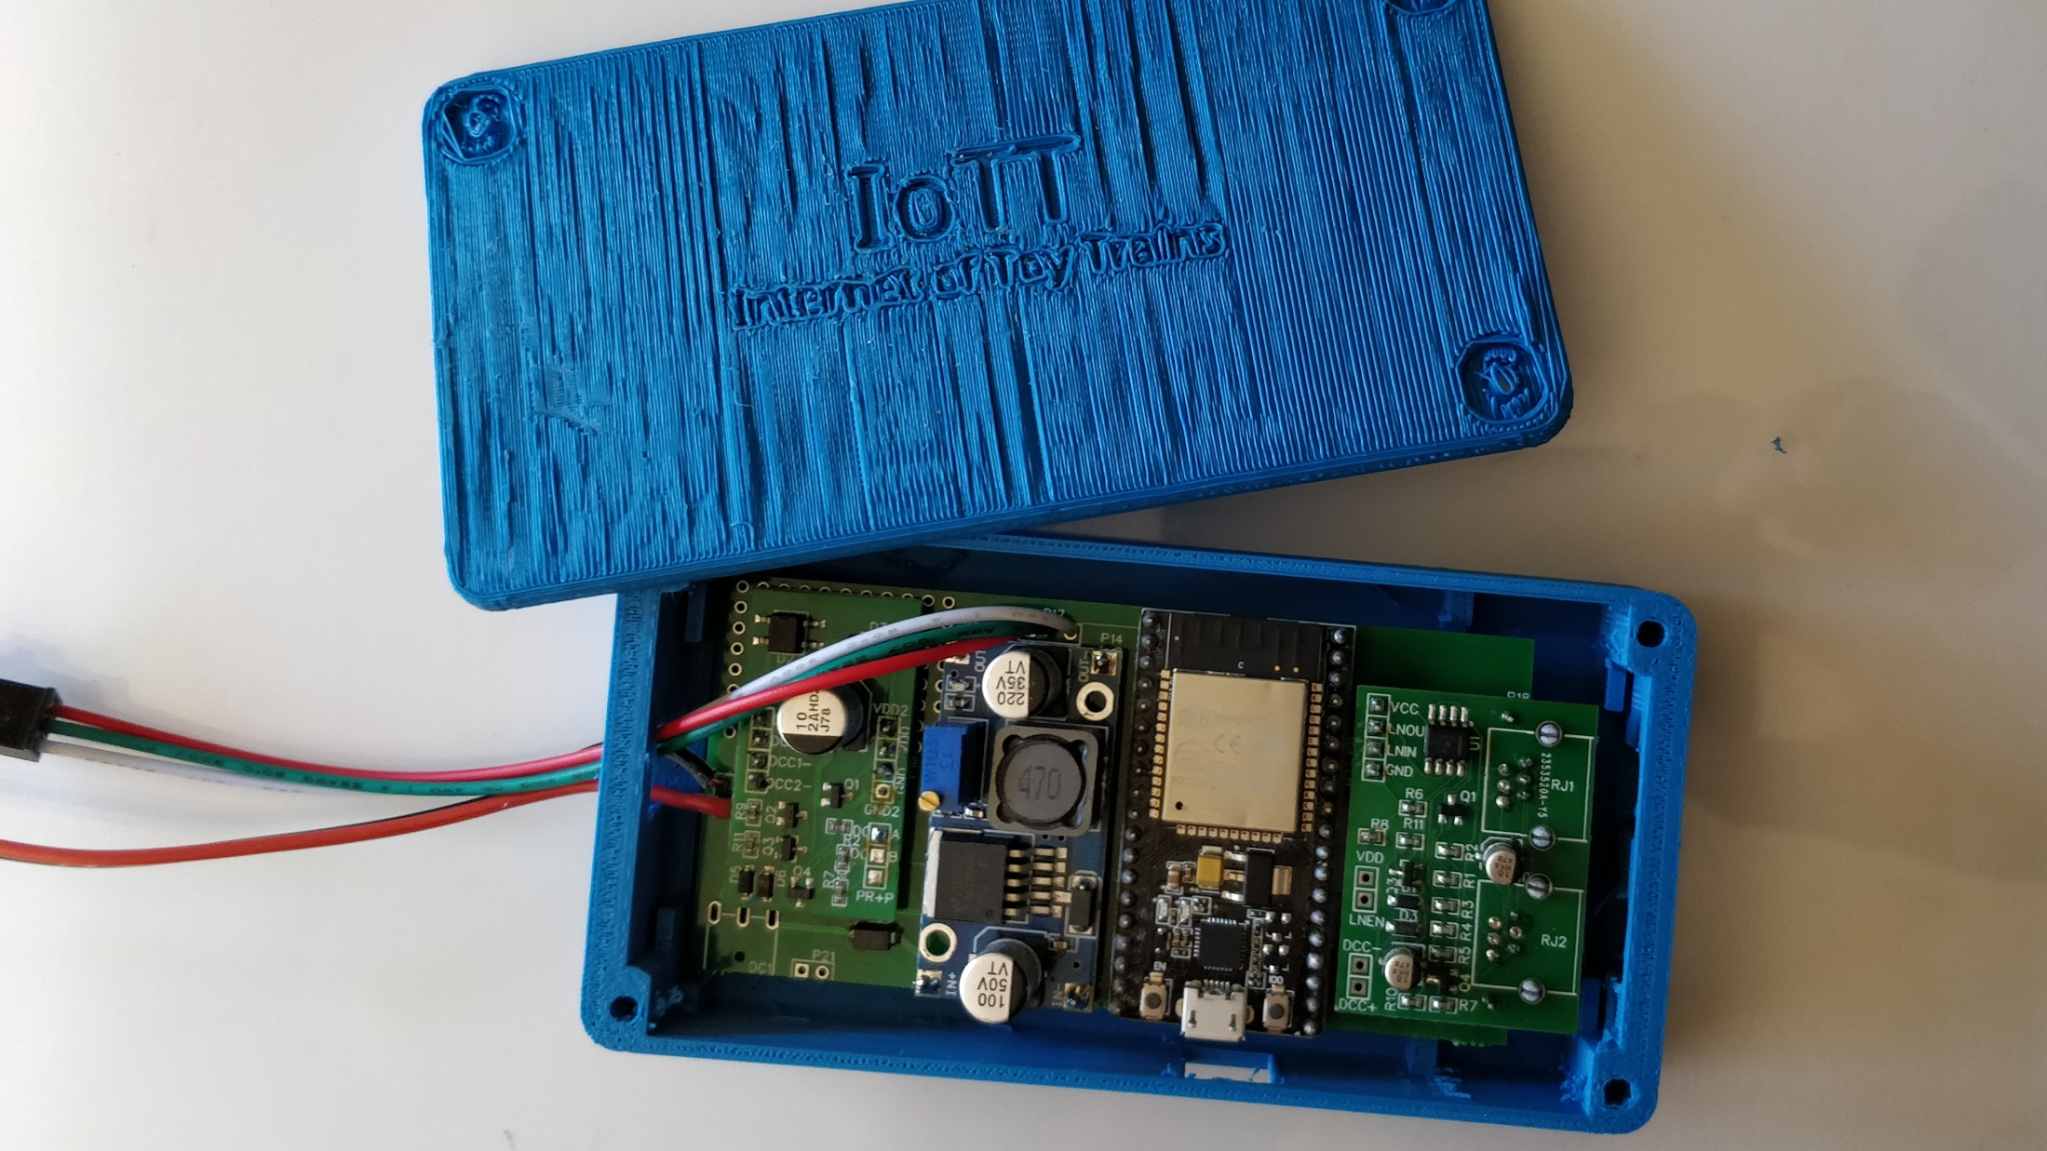

Slide 26
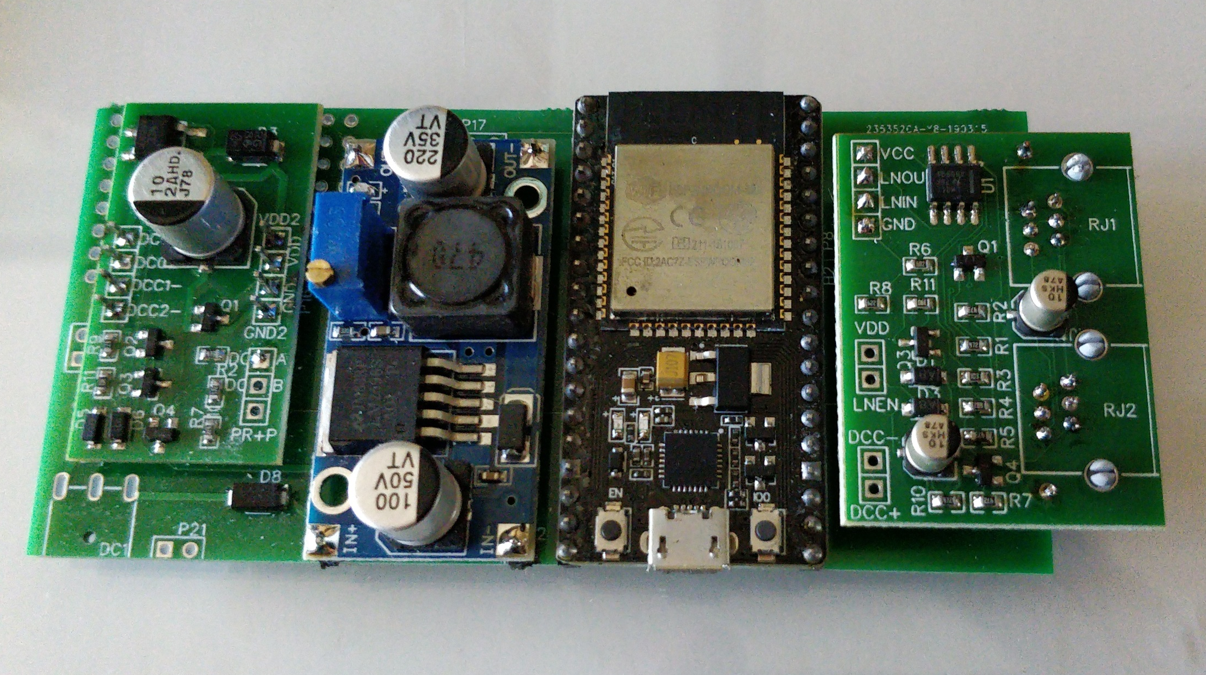
DCC Interface
Buck Converter
ESP32
LocoNet Interface
DCC Connector
DC Pin Header (5-15V, 3 Amps.)
DC Jack (5-15V, 3 Amps.)

Slide 27
Modularization Benefits
Reuse of components / modules to make different products

Slide 28
Accessory Decoder
DC+
GND
VCC
GND
Relay or Servo Driver
DC/DC Converter
Hardware Modules

Slide 29
Booster
H-Bridge Module 1
DC+
GND
VCC
GND
Touch Display
H-Bridge Module 2
DC/DC Converter
Hardware Modules

Slide 30
Modularization Benefits
Reuse of components / modules to make different products
Upgradeability of components / modules

Slide 31
Modularization Benefits
Reuse of components / modules to make different products
Upgradeability of components / modules
Adding functionality for new product releases

Slide 32
BlueBox Software Structure
BlueBox Software
Wifi Access Configuration
LED Display Configuration
Address Mode Configuration
Basic Structural Data (Signal Heads, Aspects, LED Colors)
User Application Data
LED Display Chain
Aspect Display Generator
Wifi & Web Server
BD Status
Switch Status
Signal Status
MQTT Interface
DCC Interface
LocoNet Interface
Current Occupancy Statuses
Current Turnout positions
Current Signal Aspects
Runtime Data

Slide 33
Summary
The BlueBox consists of individual modules that can be used in different combinations for various products
The modules are breadboard–friendly so that it is easy to use them for development purposes
Standard elements can be purchased as catalog components and combined to final products. The base PCB serves as integration platform
There is a realistic chance that I make individual modules and even product PCBs available for purchase. Stay tuned for more information on this topic.

Slide 34

if (watching_this(video) == (useful || interesting))
{
please_click_like();
}

Slide 35
Additional Materials on Github: https://github.com/tanner87661/IoTT-Video16
Schematics and PCB design software: https://easyeda.com
PCB supplier used for the PCB’s in this Video: https://jlcpcb.com/
NodeMCU 32S: https://www.amazon.com/AZDelivery-Nodemcu-CP2102-Module-Development/dp/B07F877YZQ/ref=sr_1_7?keywords=nodemcu+32s&qid=1553356380&s=gateway&sr=8-7
Buck Convertor: https://www.amazon.com/gp/product/B01GJ0SC2C/ref=ppx_yo_dt_b_asin_title_o06_s00?ie=UTF8&psc=1
All other electronic components: https://www.mouser.com/
ESP32 Signaling system software on Github: https://github.com/tanner87661/IoTT-Video14
NMRA 9.2.1: https://www.nmra.org/sites/default/files/s-9.2.1_2012_07.pdf
LocoNet PE Documentation: http://www.digitrax.com/support/loconet/loconetpersonaledition.pdf
More on Product Structuring and Modulariztion: https://www.true-north.consulting/topics/product-structuring/
Layout Intro Sequence Outdoor Layout: Beat Deola, Switzerland​

Slide 36
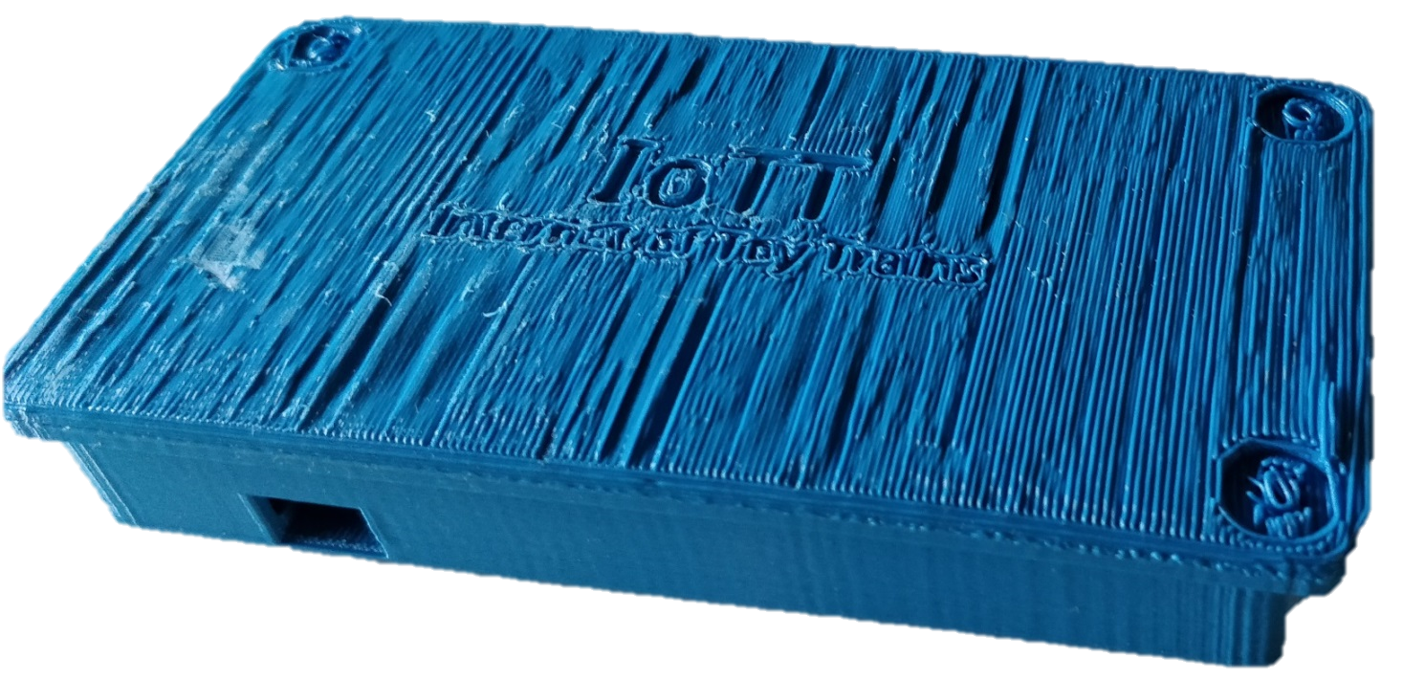
Signaling
System
Hardware

Slide 37




IoTT
Internet of Toy Trains

